Slide 1
February 23rd
Physiological function of Huntingtin

Slide 2
Physiologic function of wild-type huntingtin:
Cell survival, anti-apoptotic function

Slide 3
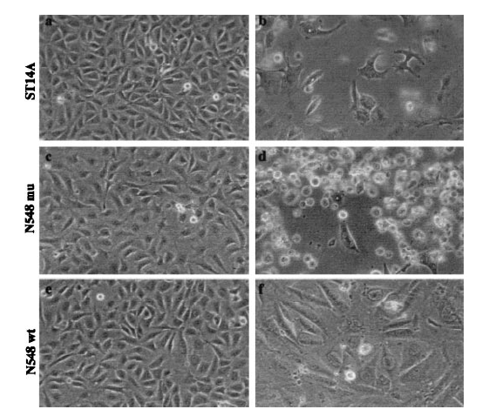
Cell death is prevented by huntingtin wt, but is promoted by huntingtin PolyQ mutant
Normal
Serum withdrawal
N548Mu
Immortalized embrional striatal cells
N548WT
Rigamonti et al., 2000

Slide 4
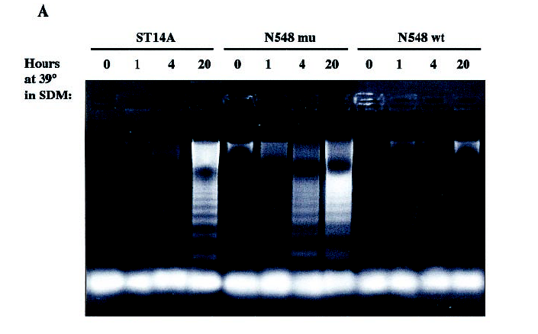
Temperature-dependent apoptotic DNA fragmentation is sustained by huntingtin PolyQ mutant, but is prevented by huntingtin wt
Rigamonti et al., 2000

Slide 5
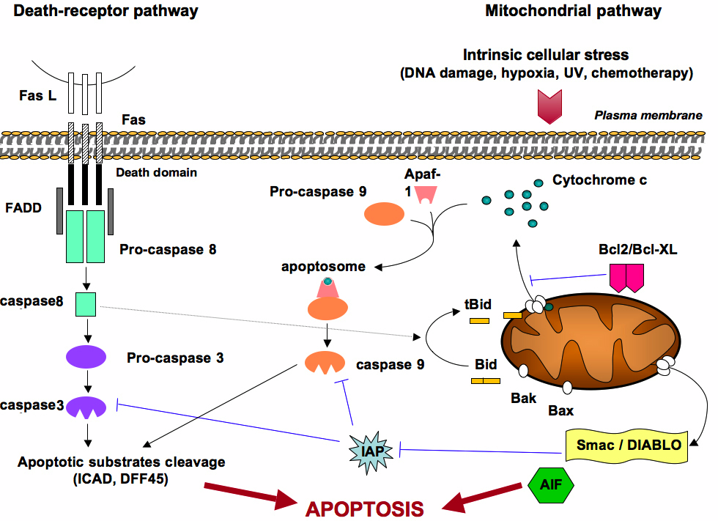
Wt HTT interferes with exogenous Apoptotic Pathway
HIP1
http://www.bioscience.org/
-Huntingtin has an ANTI-APOPTOTIC function, both downstream Bcl2 and caspase 9, and downstream the Death Receptor pathway, sequestering the pro-apoptotic HIP-1 (which contains a death-effector domain that interacts with wild type but not with mutant huntingtin).

Slide 6
Physiologic function of wild-type huntingtin:
modulating the expression and the transport of BDNF
(Brain Derived Growth Factor) to striatal neurons

Slide 7
-Peculiarity of HD is that degeneration occurs specifically in striatal neurons, although Huntingtin is ubiquitously expressed.
-It is known that Huntingtin promotes neuronal survival (and is required during development).
-BDNF has certainly a role in maintaining the “health” of striatal neurons. In facts, BDNF:
a) promotes growth and differentiation of striatal neurons
b) protects striatal neurons from excitotoxicity

Slide 8
A role for Huntingtin in the regulation of BDNF?

Slide 9
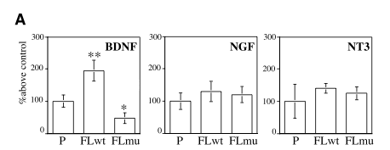
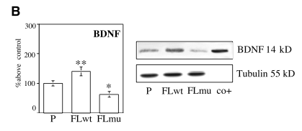
Wild-type huntingtin, but not mutant PolyQ huntingtin, specifically increase the levels of secreted and cellular BDNF
in cell culture
Zuccato et al., 2002

Slide 10
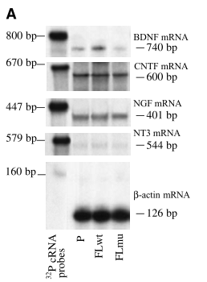
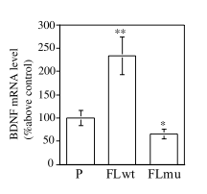
The same effect is observed in BDNF mRNA
Zuccato et al., 2002

Slide 11
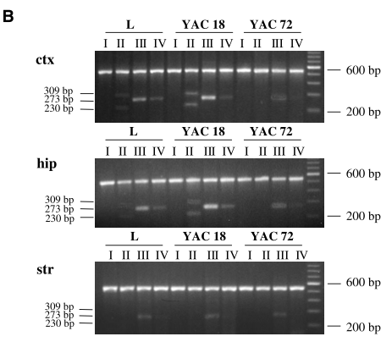
Wild-type HTT increases, but mutant HTT decreases, levels of the BDNF promoters transcripts, in cortex and hippocampus BUT NOT in striatum
YAC18= transgenic wild-type huntingtin
YAC72=transgenic mutant polyQ huntingtin
Zuccato et al., 2002

Slide 12
BDNF seems likely to be produced in cortex and hippocampus, and to be subsequently transported by afferents to the striatal neurons
What happens in the cortex of HD patients?

Slide 13
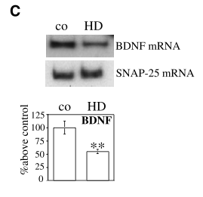
Levels of BDNF mRNA are reduced in cortex of HD patient
Zuccato et al., 2002

Slide 14
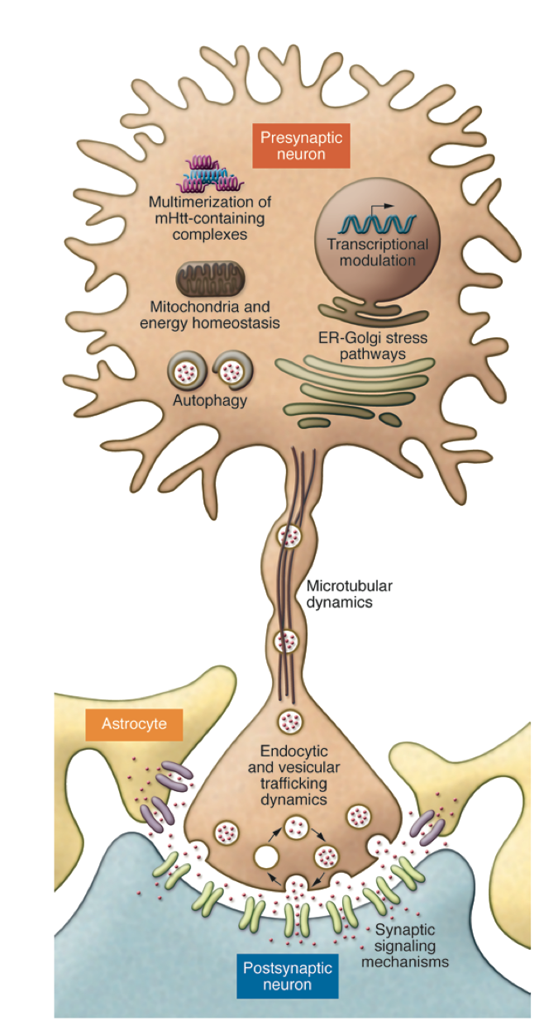
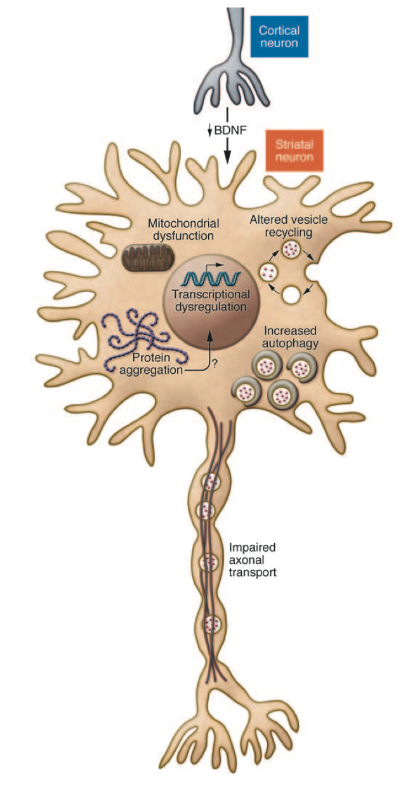
Loss of BDNF support in HD:
Toxic role of mutant htt
J Clin Invest. 2011;121(2):500-507

Slide 15
Pathogenic mechanisms of mutant PolyQ huntingtin:
Htt processing and formation of aggregates

Slide 16
Processing of PolyQ, mutant huntingtin
Cdk5, Akt
NH₂
PolyQ
P
COOH
aa1
aa3144
Cleavage by caspase 2, 3, 6
calpain
NH₂
COOH
N-terminal
fragment
C-terminal
fragment
N-term fragment forms aggregates

Slide 17
Different translocation of PolyQ, mutant huntingtin
N-terminal fragment
NH₂
N-terminal
fragment
Larger aggregates
Misfolded protein
Nucleus
Synapse
activates caspase-1 positive feedback in regulating apoptosis
Glu vesicle
Inhibition of Glu Transporter
Transcription
Transport of vesicles

Slide 18
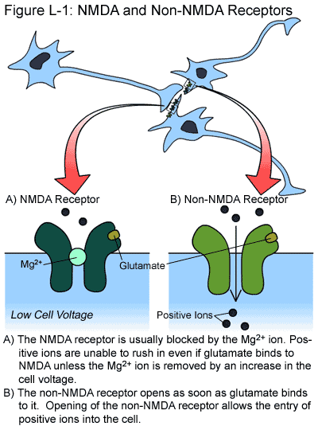
Excitotoxicity: How excess of Glutamate may trigger toxic mechanisms
http://web.stanford.edu/group/hopes/cgi-bin/wordpress/2011/06/about-glutamate-toxicity/

Slide 19
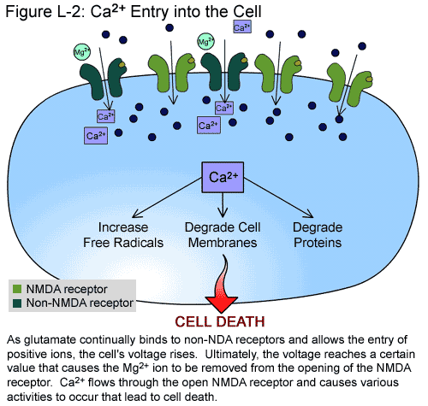
Increased Calcium entry secondary to changes in the membrane potential
http://web.stanford.edu/group/hopes/cgi-bin/wordpress/2011/06/about-glutamate-toxicity/

Slide 20
How does the CAG, PolyQ expanded motif cause HD?
-Mitochondrial dysfunction, that leads to mitochondrial disruption of Ca⁺⁺ homeostasis: trigger of cytochrome c and caspase-dependent apoptosis.
-Formation of intranuclear aggregates causing:
a) reduction of the transcription of neurotrophic factors (like BDNF Brain-Derived Neurotrophic Factor), that are essential for the neuronal growth and survival (REST/NRSF).
b) transcriptional deregulation due to the recruitment also of transcription factors (CREB binding protein CBP).

Slide 21
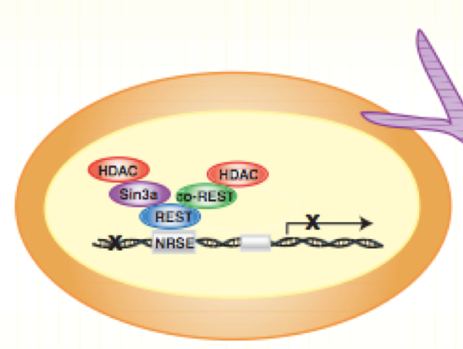
RE1-Silencing Transcription factor (REST), aka Neuron-Restrictive Silencer Factor (NRSF)

Slide 22
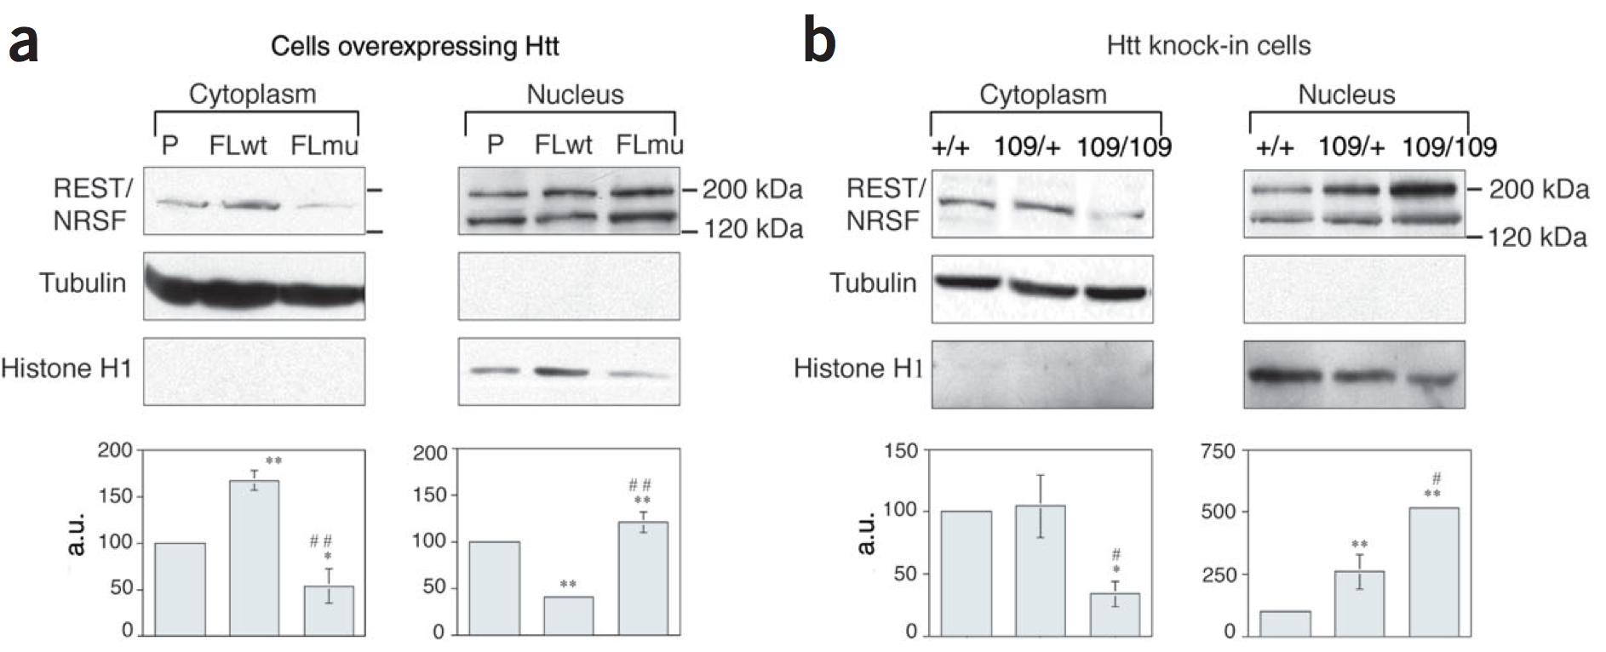
WT or mut HTT differently affect REST
intracellular localization
RE1-Silencing Transcription factor (REST), aka Neuron-Restrictive Silencer Factor (NRSF)

Slide 23
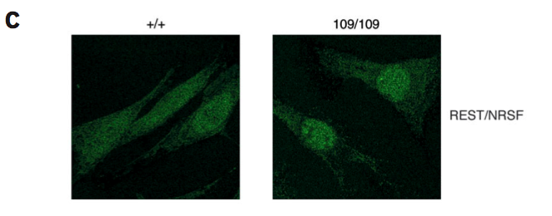
Mutant HTT redistributes REST to the nucleus

Slide 24
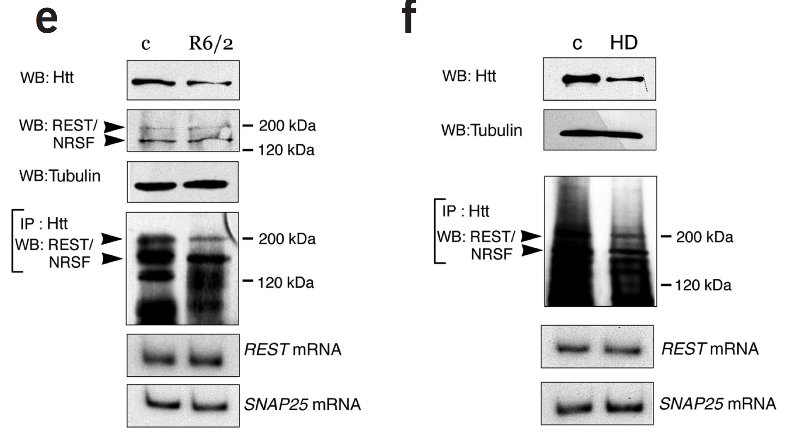
REST interacts with wt HTT in NON-HD cells.
In HD, REST interacts with HTT to a lesser extent.

Slide 25
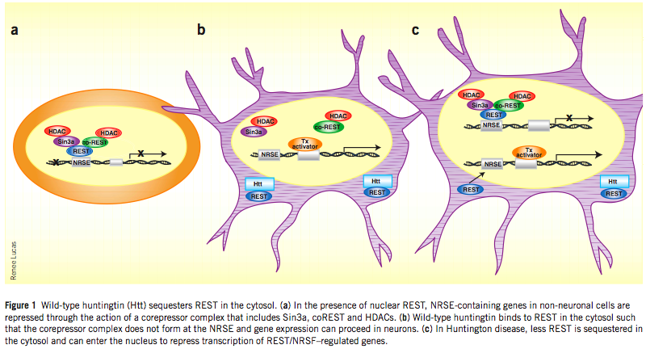
Wild type HTT sequesters REST in the cytosol
reducing its activity

